Slide 1
PROCON Prototype Overview
Christoph Mayr-Dorn
christoph.mayr-dorn@jku.at

Slide 2
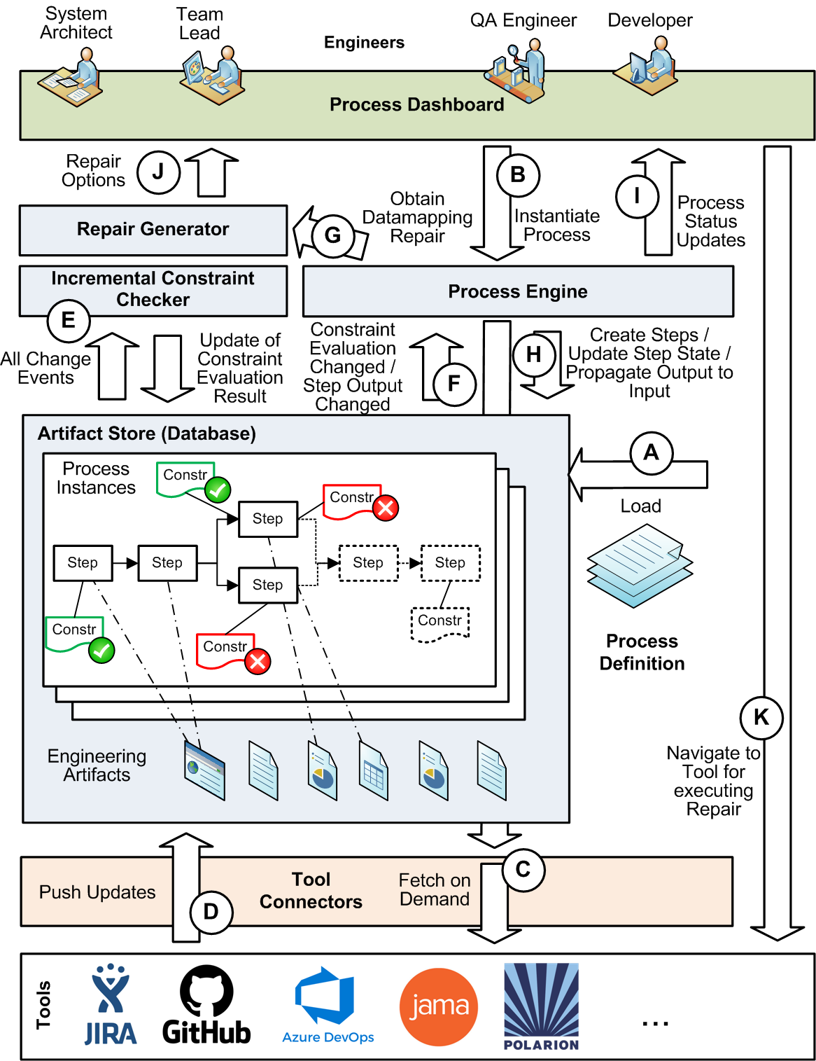
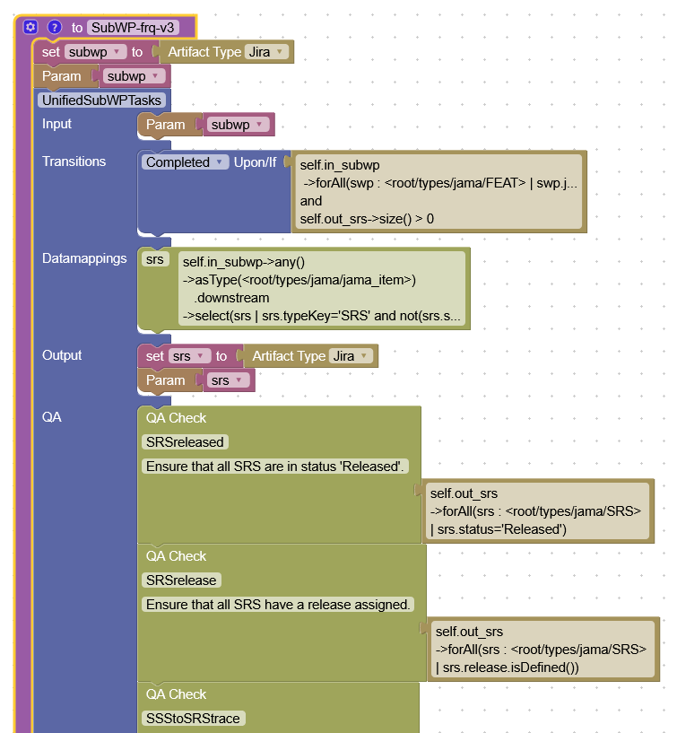
Prototype ARCHITECTURE

Slide 3
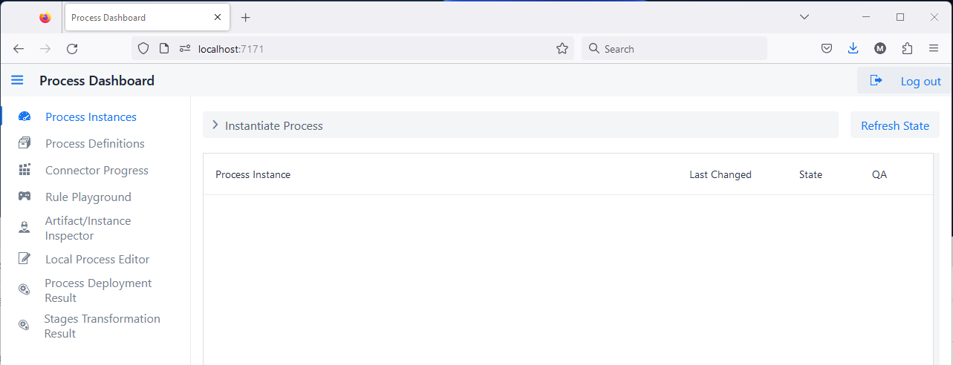
QA Tool DASHBOARD
Navigating to [URL] port 7171, logging in with dev:dev
Forces refreshing of overview – usually UI updates automatically (does not force fetch artifacts!)
Currently active process and QA check instances
Loaded/Deployed processes and QA checks
Status on fetching artifacts from backend tools
Trial running new rules/constraints
Blockly-based process editor (if enabled)
Blockly-based process deployment results (if enabled)
Results upon process deployment from Stages (if enabled)

Slide 4
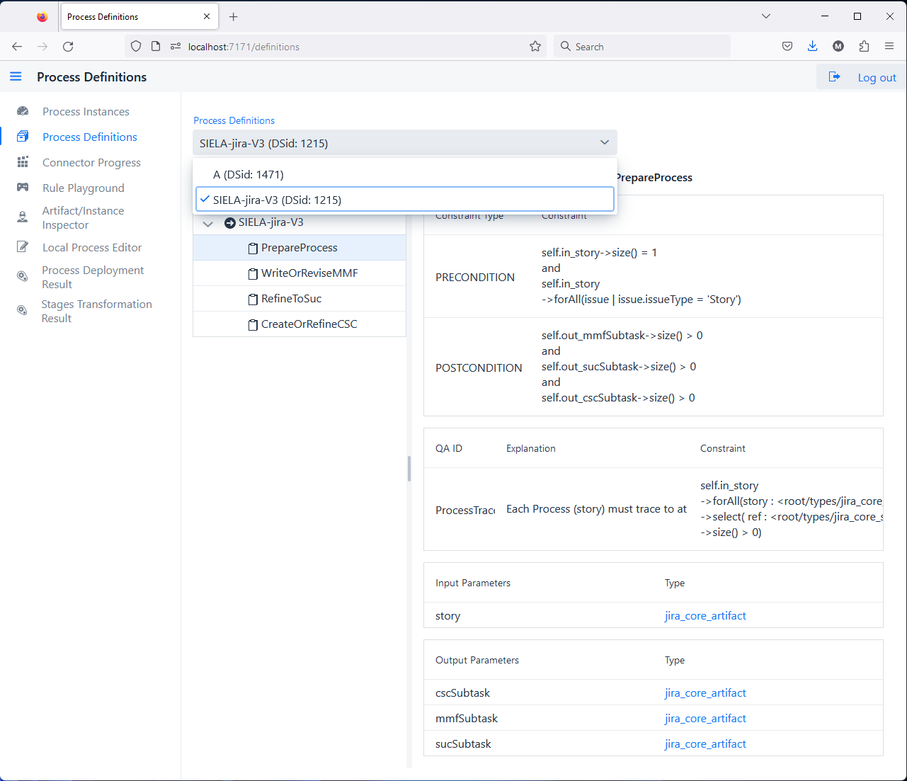
Loaded/DEPLOYED PROCESSES (incl their QA checks)
Lists all available (correct) process definitions*
* Incorrect processes are available in the back as a STAGING version, but not listed here.
Hierarchical/Tree structure of process steps and any (optional) decision nodes (AND, OR, XOR)
Displays selected process or process step details:
Including description, pre/post condition (in OCL/ARL language)
Any QA checks
Input parameter name and type
Output parameter name and type
Slider enables for size adjustment of details pane
Notes:
* Incorrect processes are available in the backend in a STAGING environment, but not listed here.

Slide 5
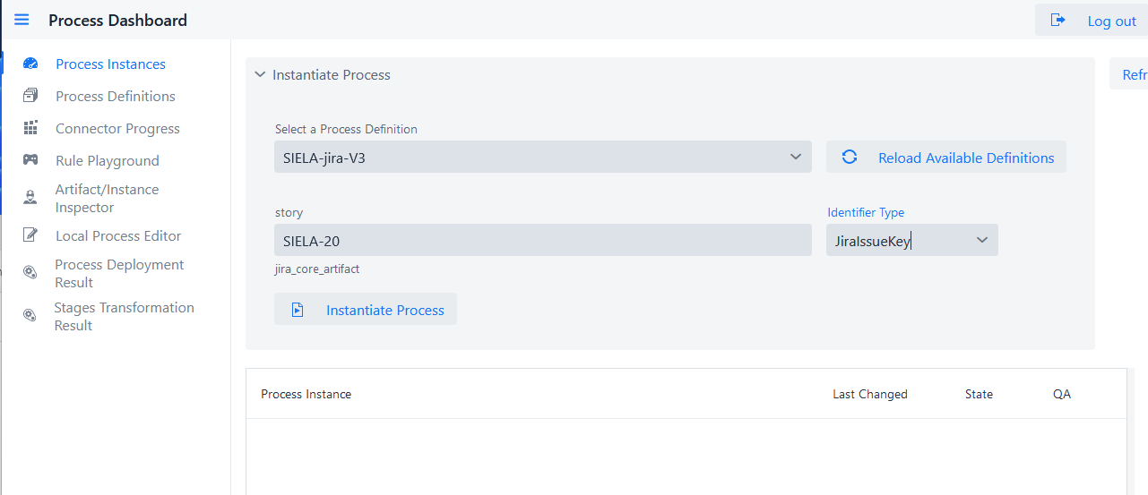
CREATING A PROCESS INSTANCE
Select Process
For every input required (as defined by the process) provide the input artifact identifier*
select type of provided ID (e.g., Jira and Jama allow different identifier types)
Initiates fetching of input artifact(s) which may take time – fetch progress is shown in connector overview
UI is automatically refreshed upon completion
* Artifact identifier format differs depending on tool:
Jira: issue [key] or [id] number
Jama: [id] or [docKey]
AzureDevOpsServices: [projectname/id]
Notes:
* Artifact identifier format differs depending on tool:
Jira: issue [key] or [id] number
Jama: [id] or [docKey]
AzureDevOpsServices: [projectname/id]

Slide 6
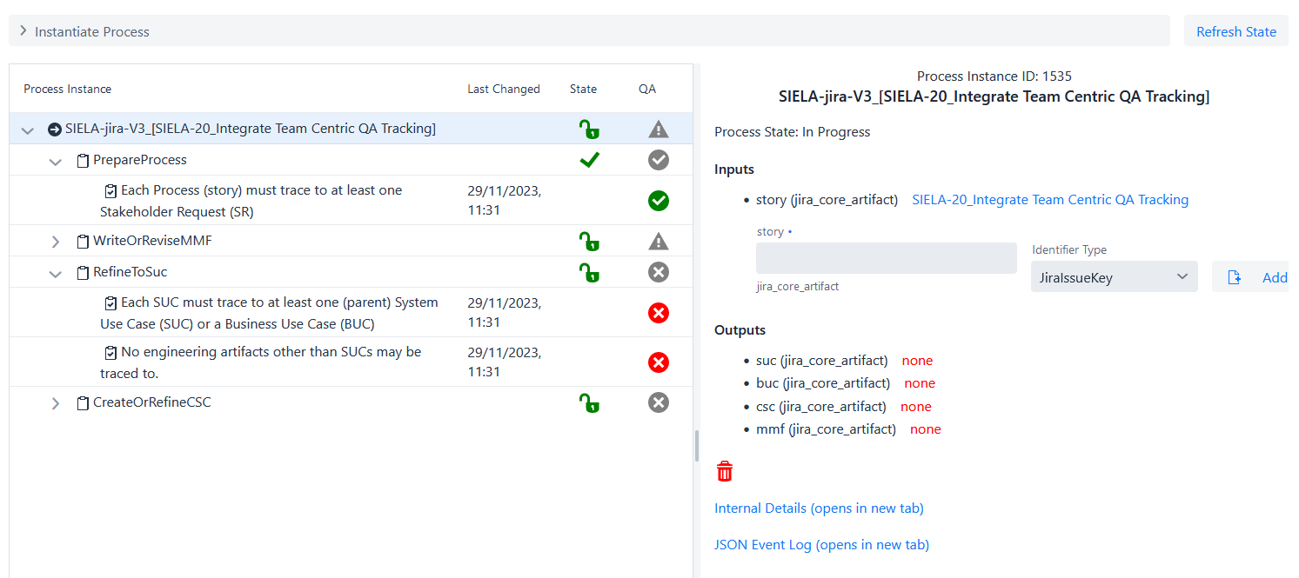
Process instance overview
Root process allows replacement of input artifact by adding new and then removing old artifact
Hierarchical process structure, indicating completion and QA status
Step with collapsed QA status
Step with expanded QA status
Provides access to how the process and artifact properties are internally stored (e.g., for checking if an artifact update in the tool (e.g., Jama, Jira, etc.) has already been received.
A history of the states each step and QA constraint has already reached earlier.

Slide 7
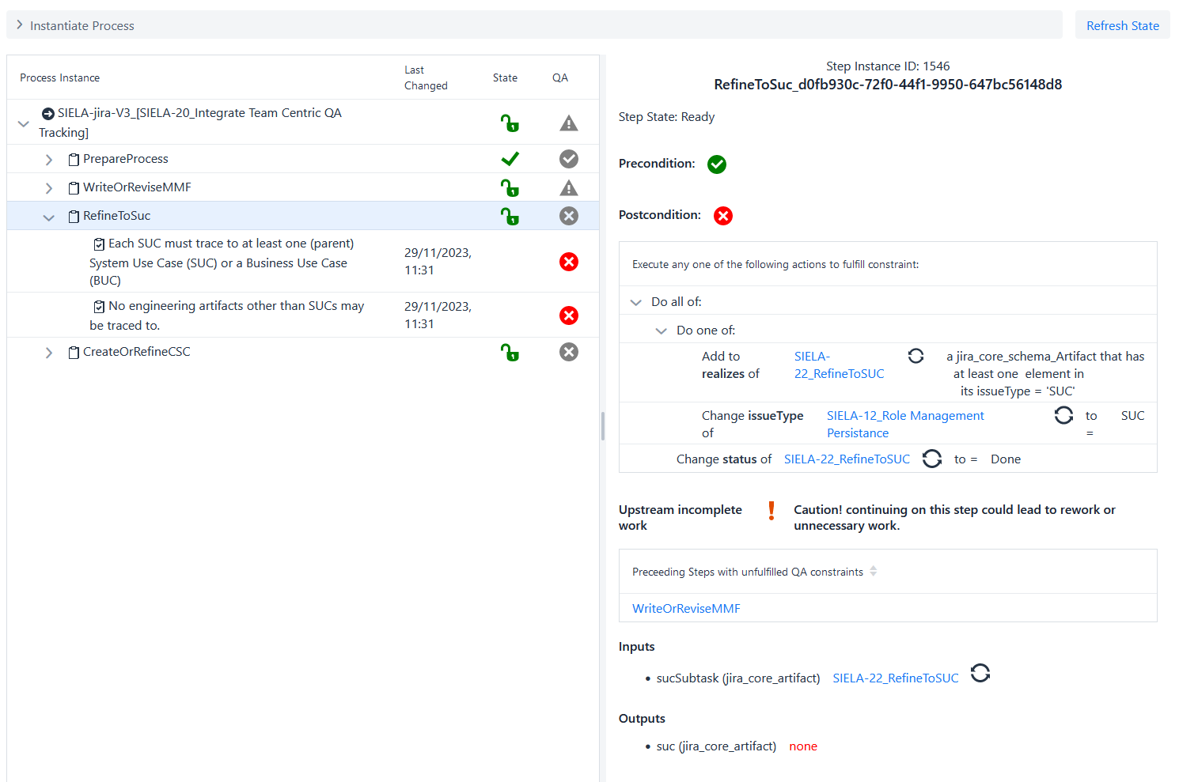
Step DETAILS
Precondition fulfilled: i.e., step is ready to be worked on
However, prior steps are incomplete
Post conditions here are not fulfilled, these are the actions (and alternatives) to signal that the step is done
This is the input of the step that is used to find the output: i.e., any output of a step needs to be reachable from its input artifacts (as defined in the process)

Slide 8
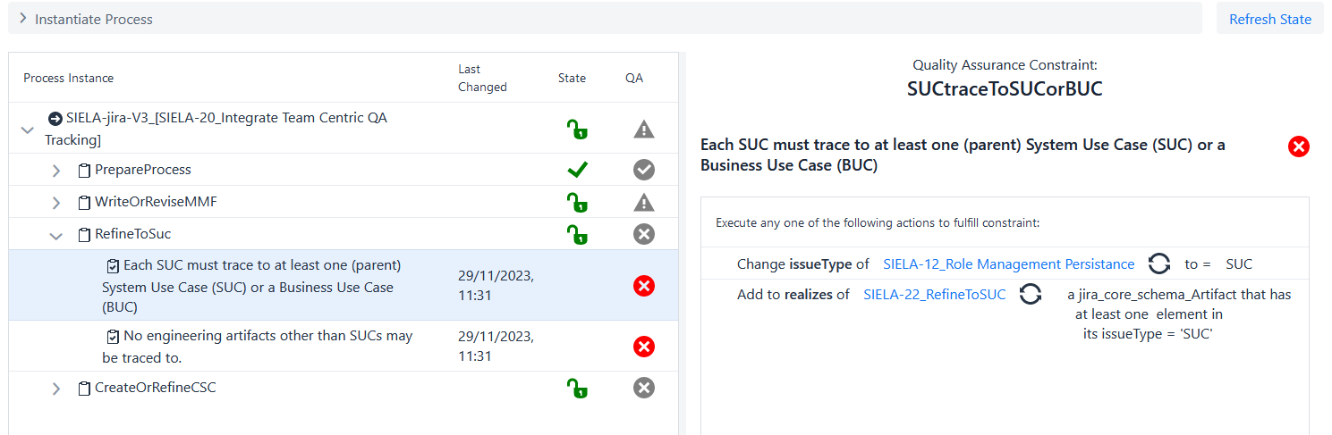
QA Constraint FEEDBACK
When enabled in the configuration, the clicking this symbol forces an immediate refreshing of this artifact (and only this artifact) from its tool with subsequent constraint reevaluation
The alternative ways to fix the QA constraint.
Action: add/remove/change
Property/field that needs changing (could be a link or reference to another artifact)
Repair details such as value to use, or restrictions on the artifact to create/link/reference …
Artifact (i.e., workitem, issue, etc) that needs changing (clicking on link opens that item in a new tab in its original tool like Jira, Jama, AzureDevOpsServices, …)

Slide 9









StatUS SYMBOLS
Symbol | Status | Explanation
 | Not Ready | Preconditions are not fulfilled
 | Ready | Preconditions are fulfilled
 | Completed | Postconditions and QA Constraints are fulfilled
 | No QA defined | This step does not have any QA constraints
 | Step’s QA state | This step/process has all/none/some QA constraints fulfilled
 | Fulfilled | QA constraint are fulfilled
 | Violated | QA constraint not fulfilled

Slide 10
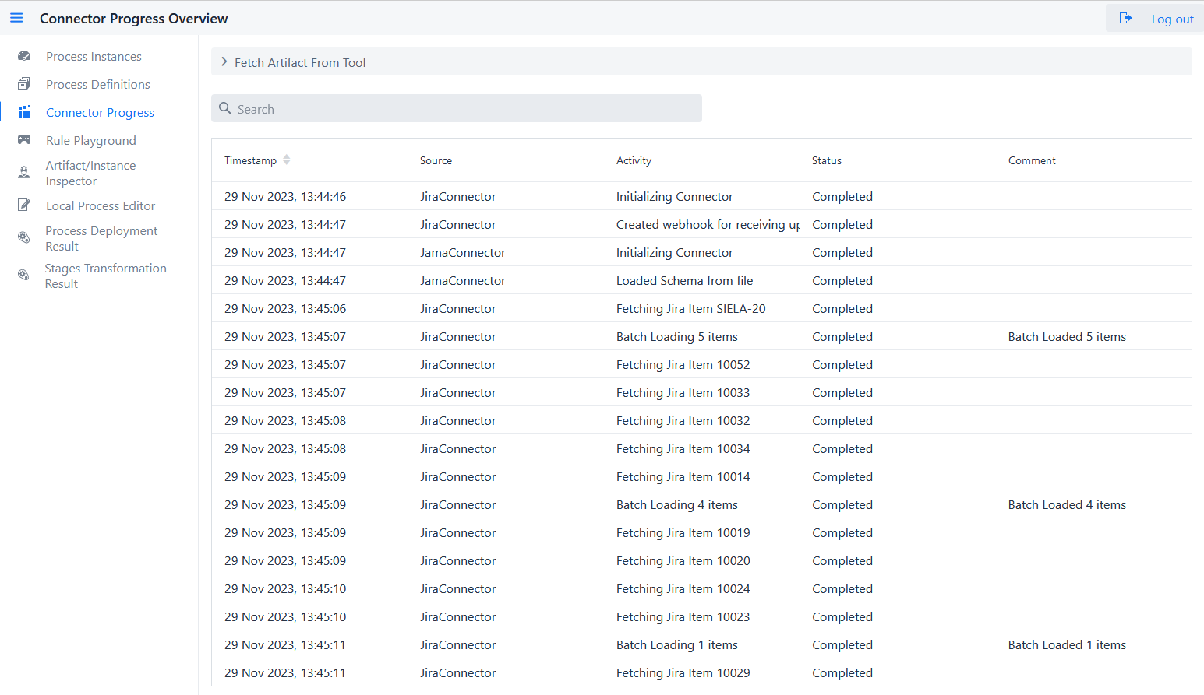
Tool Connector PROGRESS
Connectors initialization
Fetching of SIELA-20 and all further necessary issues based on constraint evaluation
(e.g., when a constraint needs to inspect all downstream artifacts, it will trigger their fetching from the tool)

Slide 11
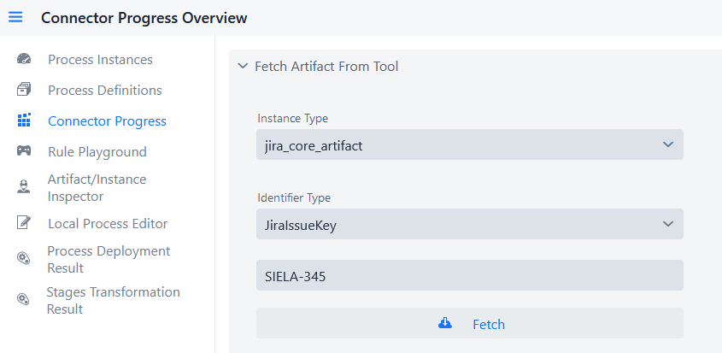
Fetching individual Artifacts
Fetching of artifact from tool (if not already locally available) by providing the type, identifier type, and id (in the same manner as for providing process input)
Note that relations/links to other artifacts result in lazy loaded artifacts (that need separate fetching) unless these have already been fetched earlier.

Slide 12
Designing Constraints/PROCESSES

Slide 13
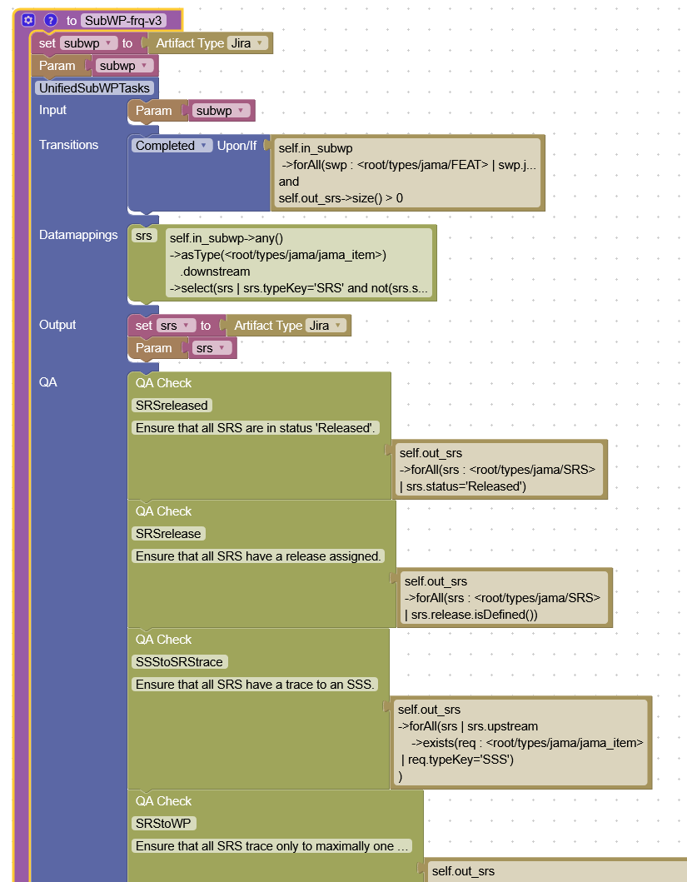
Process EDITOR
Process entry point with input definition
Process Step definition with input mapped from process
Step start/pre- and completion/post- condition
(also cancel conditions available)
How one navigates from input to output, i.e., where does output come from
Step output, and type thereof
Any QA constraints, e.g., that input needs to be traced to something else,
Context/scope is always the step, navigating via input or output of the step
Constraints are best written and tested separately first (see next slide)

Slide 14
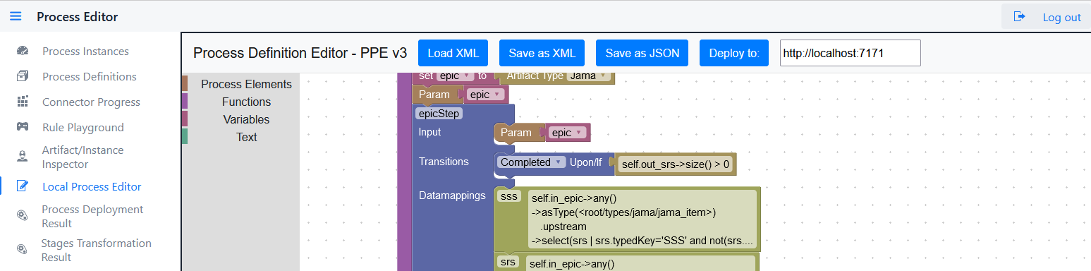
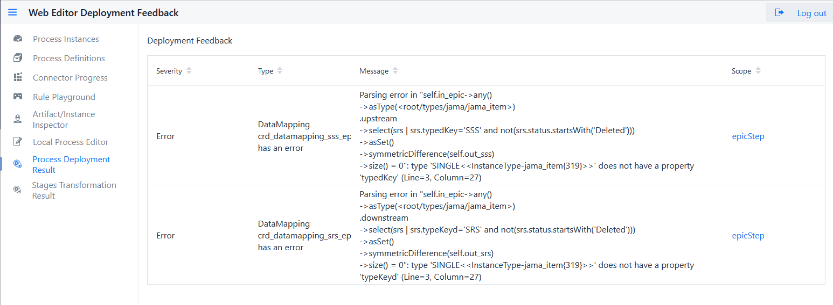
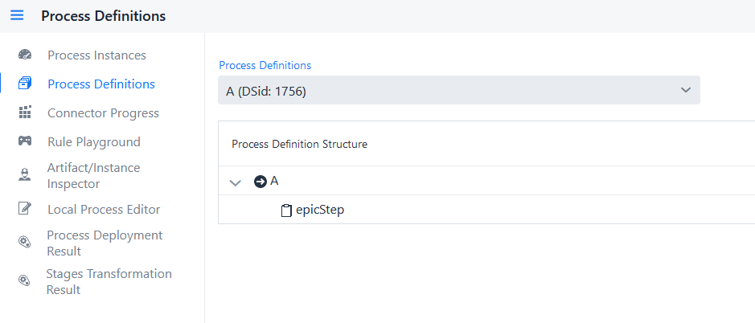
Process Deployment
* The blockly process definition is not persisted anywhere in the framework, hence the “Save as XML” need to be used to reload the process definition at a later time.
** The native json format can only be used for loading a process from the definitions folder but cannot be used for editing in the editor anymore – typically not needed as the framework can also import the blockly xml files that are stored in the definitions folder.
*** Deployment first creates a staging process for error checking, if no errors encountered, process is created. If a process with the same name exists, that process is removed and any process instances recreated with the new definition if possible (if errors occur, see Process Deployment Result page)
Load a process definition from harddrive for editing in the blockly editor
Save current process to be able to later continue editing it in the blockly editor *
Store the process definition in the framework native json format **
Makes the process available in the framework by checking for rule errors etc. ***
For deployment to a different server (e.g., production) ***
Upon successful deployment, opens the Process Definition page in a new tab
For unsuccessful deployment, opens the Deployment Result page in a new tab to provide error details

Slide 15
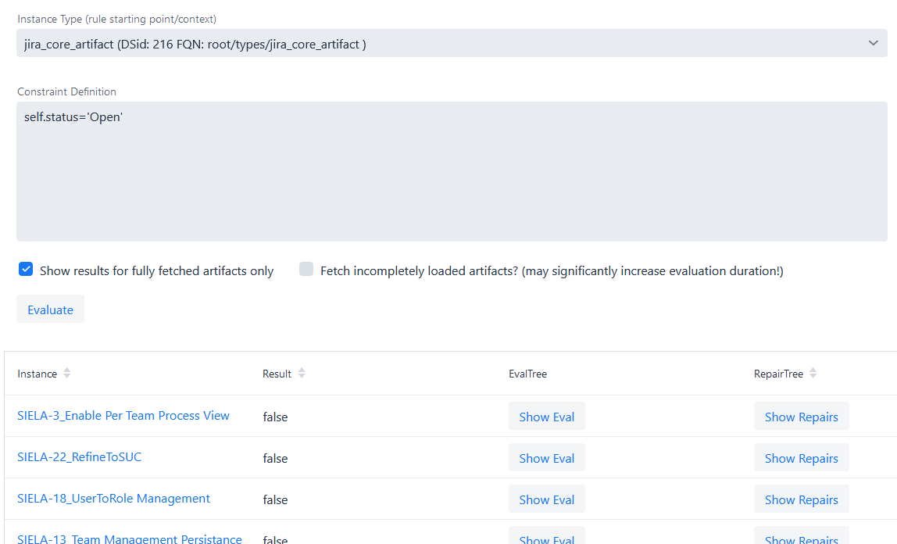
OCL/ARL Constraint PLAYGROUND
Which type of artifact should this constraint be checked against
Artifacts are loaded as needed. Hence, no loading lazy loaded artifacts might lead to incorrect constraint results but might require a lot of time if constraint checker realizes more artifacts are within the scope of the constraint and are also fetched.
All instance currently available to the constraint checker (link leads to internal representation (see next slide)
Constraint evaluation result
Shows what possible repairs the repair generator would produce for this violated constraint. (same repair view as on the dashboard)

Slide 16
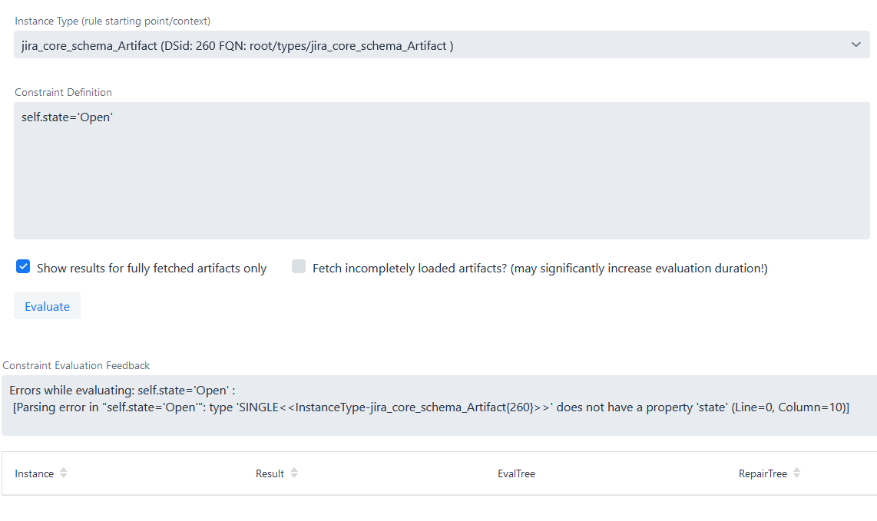
Constraint Writing FEEDBACK IN CASE OF SYNTAX ERROR
Example of constraint cannot be evaluated due to non-existing property “state”.
To inspect the available artifact properties, load an example one and inspect (see next slide) or inspect the schema definition (here id 260)

Slide 17
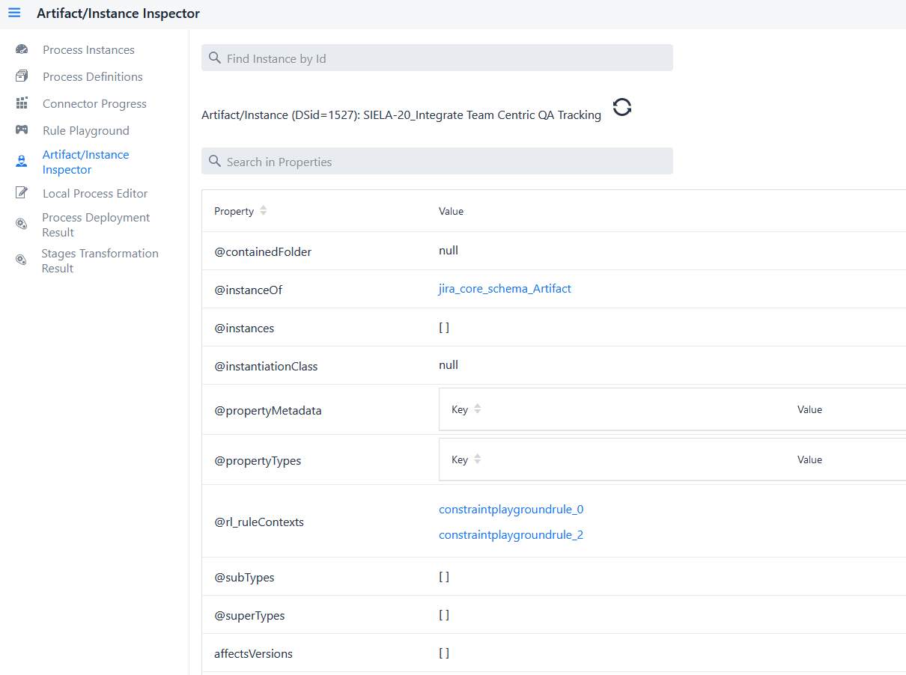

Internal Artifact REPRESENTATION
Navigate to a different internal object by internal id
Search across all properties and values
Navigate to artifact type definition
Properties starting with ‘@’ are internally created
Navigate to linked artifacts
Navigate to rule evaluation results and on to rule definitions

Slide 18
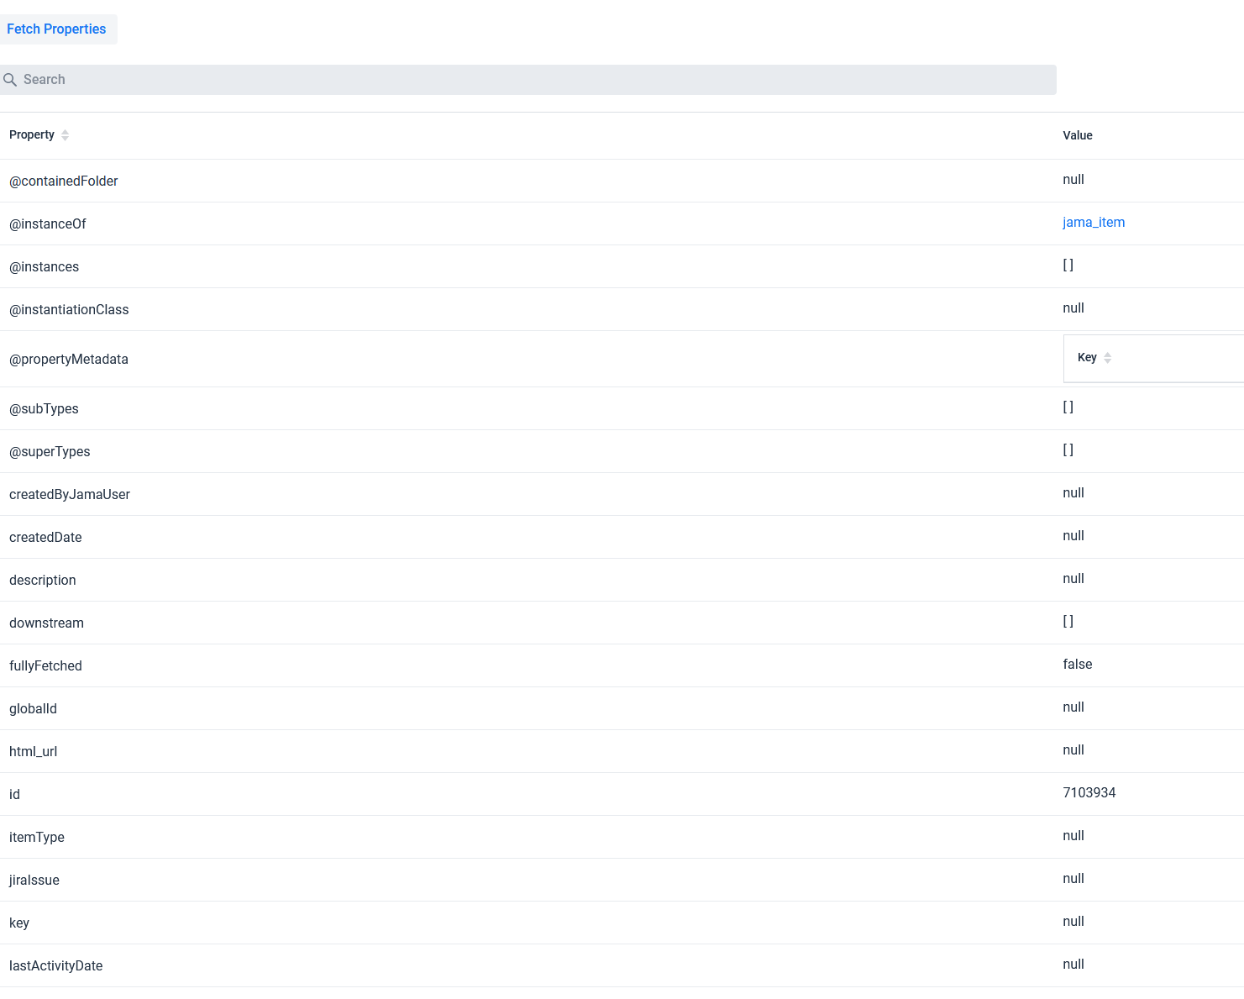
Fetching Lazy LOADED ArtifactS
Fetch Button is visible
Specific subtype is unknown yet
FullyFetched Property is ‘false’
Most properties not known or still null

Slide 19
Process Design Procedure

Slide 20
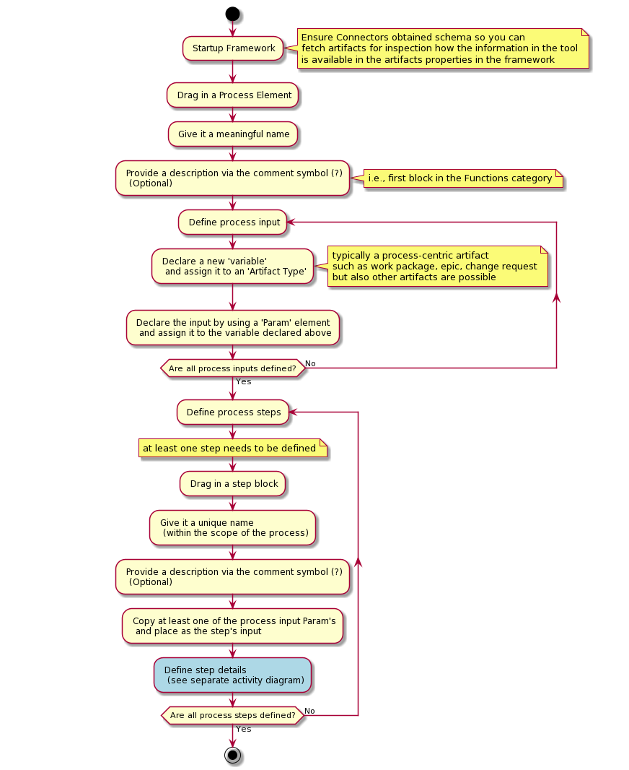
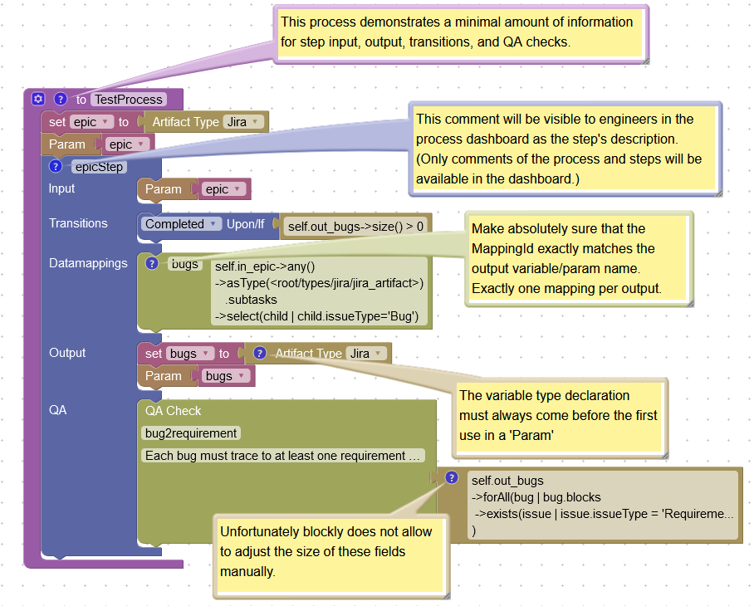
Basic Process Example

Slide 21
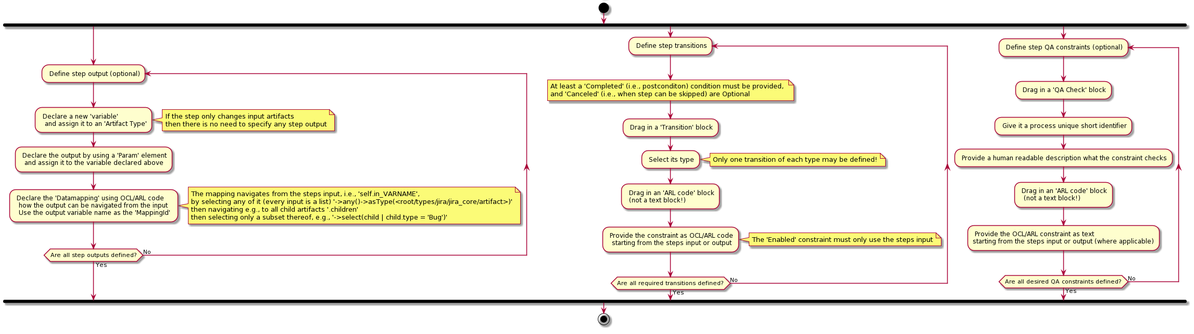
Defining Step DETAILS
Constraints used in example:
Completion/PostConditions: self.out_bugs->size() > 0
Datamapping: self.in_epic->any()->asType(<root/types/jira/jira_artifact>).subtasks
->select(child | child.issueType='Bug')
QA: self.out_bugs->forAll(bug | bug.blocks->exists(issue | issue.issueType = 'Requirement’))

